Slide 1
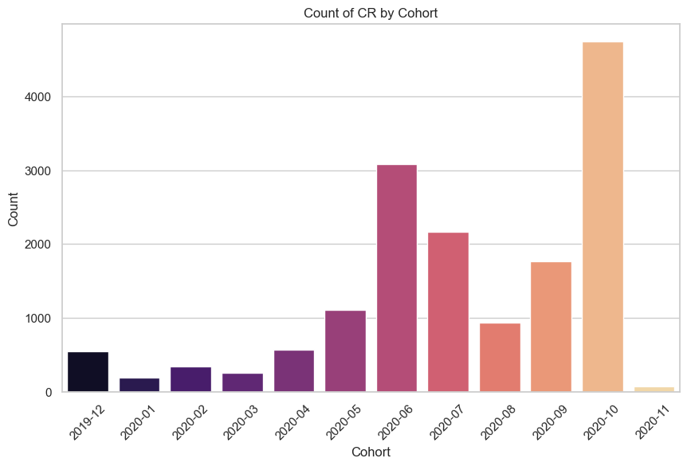
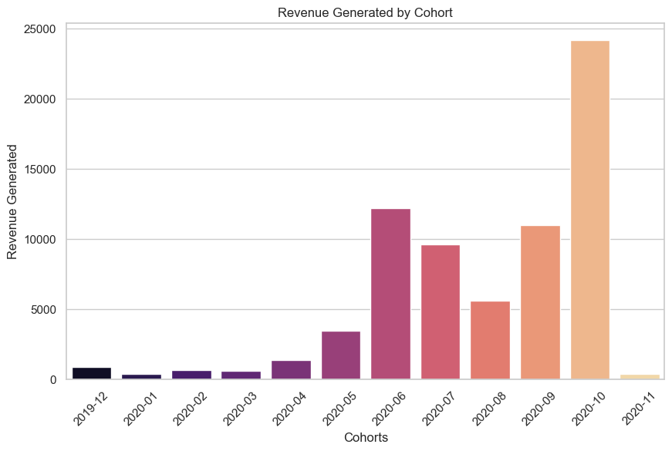
Ironhack Payments - CR and Fees Datasets Analysis
The revenue increases as cohorts make more cash requests.
There is a linear positive relationship between the amount of cash requests per cohort and revenue generated.

Slide 2
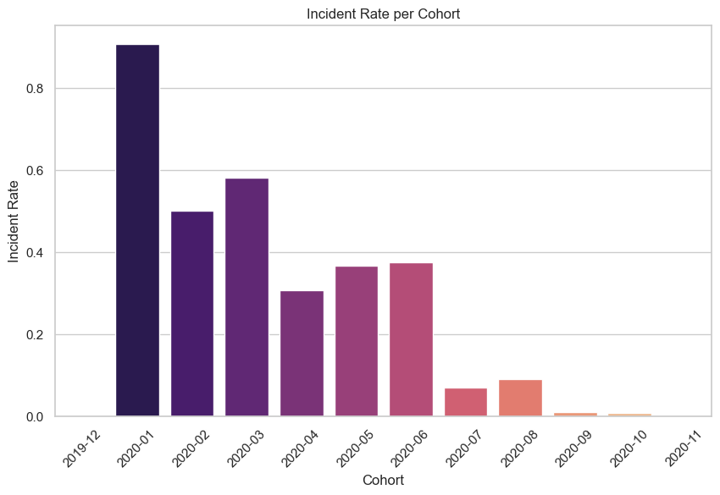
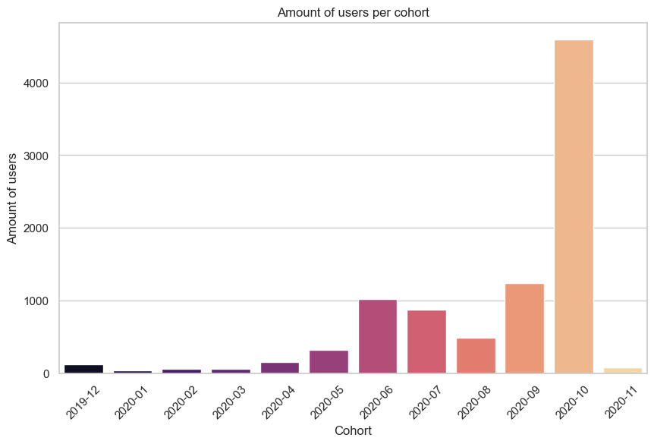
Ironhack Payments - CR and Fees Datasets Analysis
The incident rate goes down as user count increases.
We observe a 90% incident rate fin january 2020.
However, as users grow and data becomes more relevant, the IR drops below 10%.
Meaning that as we get more clients, the probability of them missing a repayment of the loan decreases.

Slide 3
Ironhack Payments - CR and Fees Datasets Analysis
The incident rate is inversely proportional to the revenue’s growth.
Meaning that as user count increases, the bulk of the fees gets generated by instant payment and postponing requests.

Slide 4
N of users in Ironhack Payments that took out at least 1 loan :
9625
N of loans in total :
17373
Average loans per user :
1.8
Max : 5 Min : 1

Slide 5
Total revenue generated by fees :
74210.0€
Total capital lended :
1’158’813€
Period : 2020-05-29 to 2020-11-01
Average % return on each loan :
8.12%

